Slide 1
GSBA 511: Managerial Economics
Prof. Akbulut
Chapter 9 (9.1-9.3)

Slide 2
Chapter 9.1-9.3: Outline
US and the International Economy
Comparative Advantage and International Trade
How Countries Gain form International Trade
Government Policies That Restrict International Trade
The Arguments over Trade Policies and Globalization

Slide 3
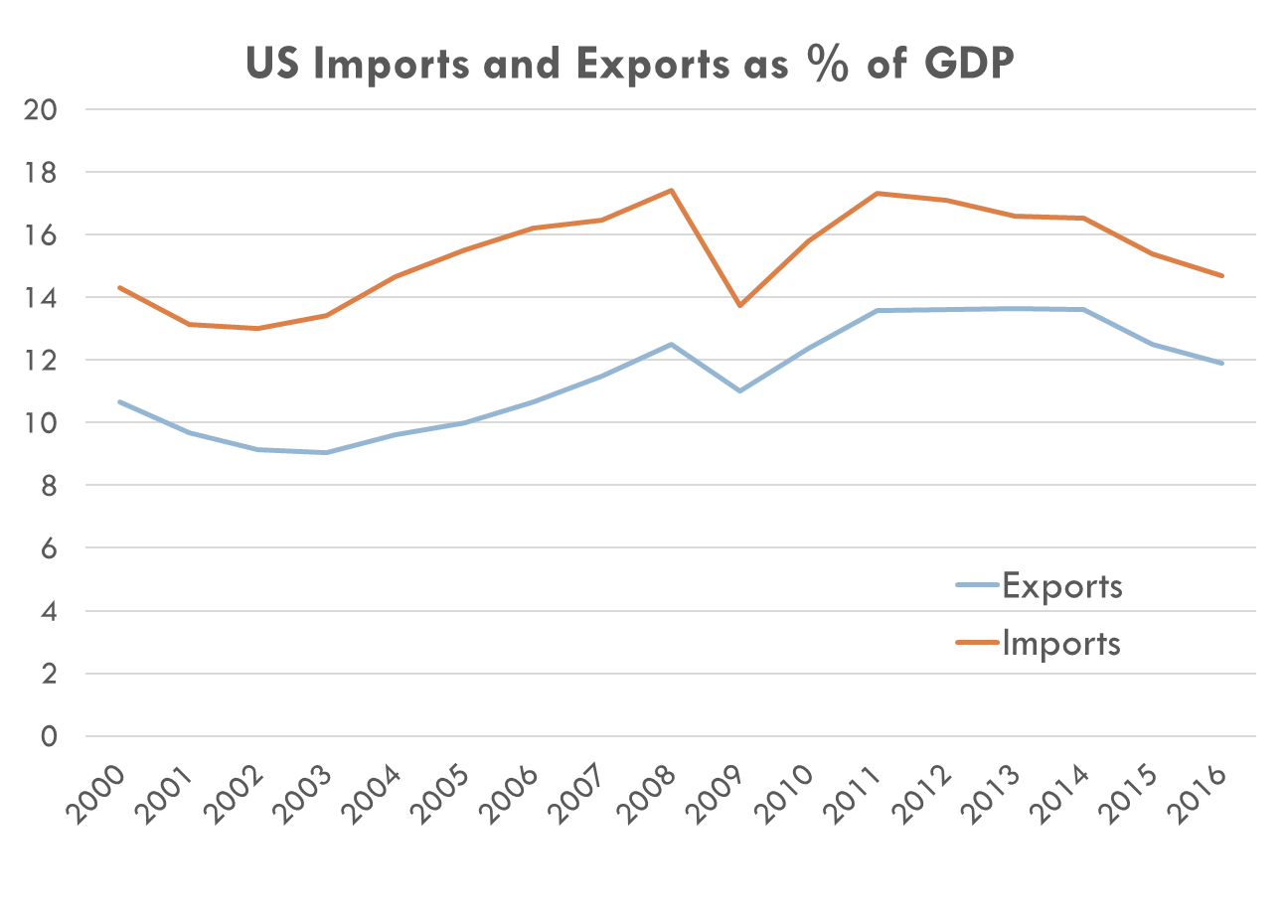

Slide 4
Source: OECD

Slide 5
Why Don’t We See Complete Specialization?
Not all goods and services are traded internationally. Some services are difficult to export, such as medical care.
Production of most goods involves increasing opportunity costs. If a country devotes more workers to producing a good, the opportunity cost of producing more of that good will increase, causing the country to stop short of complete specialization.
Tastes for products differ. Most products are differentiated. As a result, countries may each have a comparative advantage in producing different varieties of a particular product.

Slide 6
Sources of Comparative Advantage
Climate and natural resources
Relative abundance of labor and capital
Skilled vs. unskilled workers
Technology
External economies
Lower costs resulting from increases in the size of the industry in the area

Slide 7

We discussed gains from trade. Can we say that everyone wins from international trade?

Slide 8
Government Policies that Restrict International Trade
Tariffs
Taxes on imported goods
Raise revenue for domestic government
Protect domestic producers of import substitutes
Harm domestic consumers of imports and import substitutes
Import Quotas
Limits on the quantity of imports
Essentially equivalent to tariffs except they don’t raise revenue for the domestic government

Slide 9
Protectionism is usually justified on the basis of one of the following arguments:
Saving jobs. Argument is that free trade reduces employment by driving domestic firms out of business.
Protecting high wages. Some people worry that firms in high-income countries will have to start paying much lower wages to compete with firms in developing countries.
Protecting infant industries. Others argue that under free trade, established foreign producers can sell their products at a lower price and drive domestic producers out of business before they gain enough experience to compete.
Protecting national security. Reducing the risk of supply cuts.

Slide 10
The High Cost of Preserving Jobs with Tariffs and Quotas
Preserving U.S. Jobs with Tariffs and Quotas Is Expensive
Product | Number of Jobs Saved | Cost to Consumers per Year for Each Job Saved
Benzenoid chemicals Luggage Softwood lumber Dairy products Machine tools Women's handbags Canned tuna | 216 226 605 2,378 1,556 773 390 | $1,376,435 1,285,078 1,044,271 685,323 479,452 263,535 257,640

Slide 11

Dumping:
Selling a product for a
price below its cost of
production.
Difficult to determine whether foreign companies are dumping
Why do we care?

Slide 12

Other Barriers to Trade
Stricter health and safety requirements
Banning goods made with child labor

Slide 13
Active Learning: Comparative Advantage and the Gains from Trade
 | Output per Hour of Work
 | HATS | BEER
CHILE | 8 | 6
ARGENTINA | 1 | 2
Which country has an absolute advantage in in the production of hats and which country has an absolute advantage in the production of beer?
Explain which country has a comparative advantage in in the production of hats and which country has a comparative advantage in the production of beer?
What is the range of terms of trade that would benefit both countries?

